Slide 1
Design and Analysis of Three-Phase Grid Connected Inverter
Presented by:
Durga Mahesh Natham.
SE23MAEV003
Autonomous Electrical Vehicle Engineering
Mahindra University

Slide 2
Presentation outline
Abstract
Objectives of my project
Hardware Implementation
Software Implementation
Methodology
Testing
Results
Conclusion
References

Slide 3
Abstract
This project focuses on developing a three-phase grid-connected inverter using an STM32 microcontroller. The system converts DC power from renewable sources into grid-compatible AC power, requiring precise synchronization with utility voltage and frequency through sinusoidal PWM (SPWM) control and phase-locked loop (PLL) technology. The hardware implementation uses an ADEMTEK inverter stack with SKM75GB12T4 IGBT modules driven by STM32-generated gate signals. Key developments include implementing Clark and Park transformations for grid current control, designing voltage and current sensing circuits for system monitoring, and achieving successful grid synchronization using PLL technique. The system has been tested in both standalone and grid-connected operation modes, demonstrating basic grid-tie functionality. Future work will focus on improving waveform quality, system stability, output filtering, and control algorithm refinement through comprehensive testing under various grid conditions.

Slide 4
Objectives
PRIMARY GOAL:
Design, implement, and test a three-phase grid-connected inverter using an STM32 microcontroller to generate a synchronized AC output with minimal distortion, enabling seamless integration with the utility grid for renewable energy applications.
SPECIFIC OBJECTIVES:
Grid Synchronization & SPWM Control:
Implement Sinusoidal Pulse Width Modulation (SPWM) with Phase-Locked Loop (PLL) to ensure precise grid frequency and phase matching. Minimize harmonic distortion to meet grid compliance standards (e.g., IEEE 1547, IEC 61727).
Hardware Implementation:
Integrate the ADEMTEK inverter stack with SKM75GB12T4 IGBTs and gate drivers for efficient DC-to-AC conversion. Ensure proper isolation and protection circuits for safe grid interconnection.Voltage and Current Design high-accuracy sensing circuits for real-time grid voltage/current monitoring. Calibrate sensors to maintain stability under varying grid and load conditions.Closed-Loop Feedback
Closed-Loop Grid-Tied Control:
Implement Clark & Park transformations for grid current control in the dq-reference frame. Develop active/reactive power (PQ) control for grid-support functionalities.

Slide 5
Objectives
Testing:
Test synchronization under different grid conditions (voltage sag, frequency drift). Implement anti-islanding protection to ensure shutdown during grid outages.
Future Development:
Integrate reactive power compensation for improved grid stability. Develop low-voltage ride-through (LVRT) capability for fault tolerance.

Slide 6
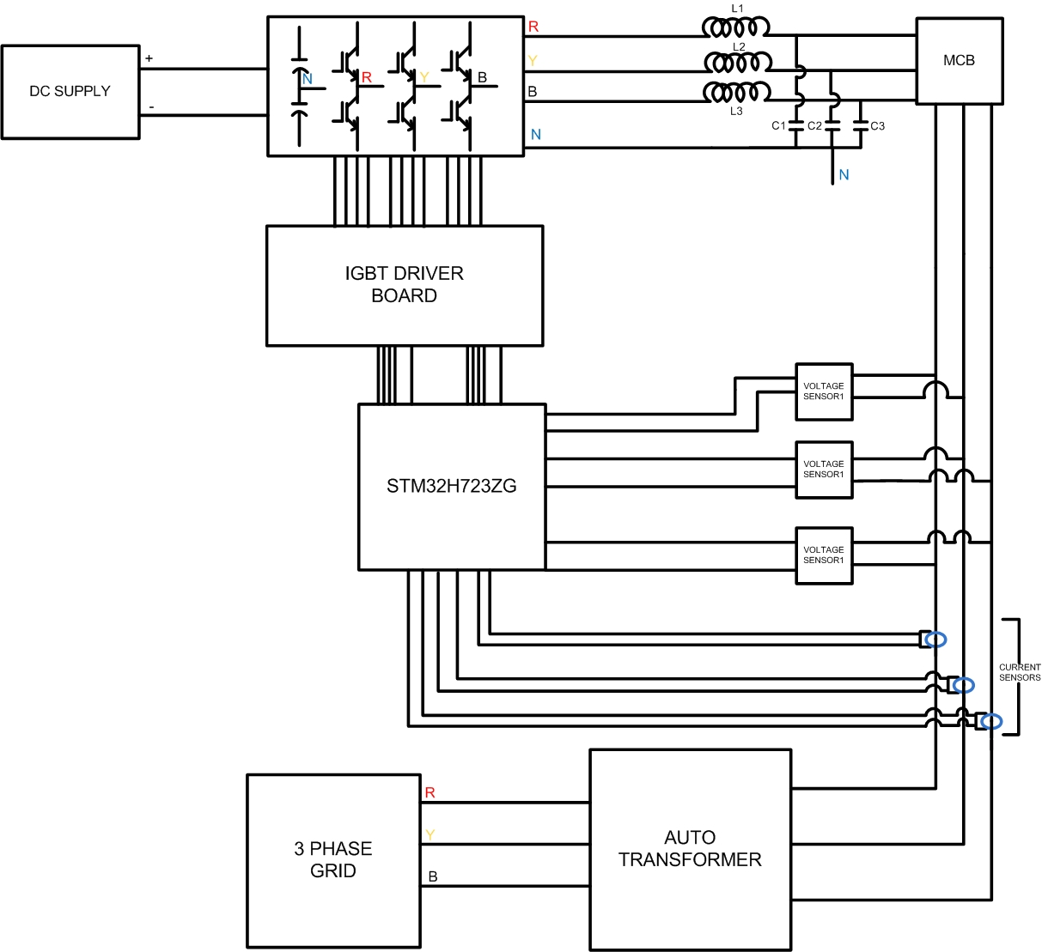
System Design
System Working Flow
Input Voltage Supply:
The DC supply provides the required input voltage to the inverter circuit.
PWM Signal Generation:
The STM32H723ZG microcontroller generates Pulse Width Modulation (PWM) signals.
IGBT Control:
PWM signals are sent to the IGBT driver board.
The driver board switches the IGBTs in a controlled manner to produce a three-phase AC output.
Noise Filtering:
The AC output passes through a filter circuit (inductors and capacitors) to:
Eliminate high-frequency noise.
Smoothen the waveform.
Harmonic reduction
Monitoring and Feedback:
Voltage and current sensors continuously monitor the inverter output.
Feedback is sent to the microcontroller for adjustments.
Output Regulation and Synchronization:
The microcontroller regulates the output voltage and frequency.
Synchronization with the three-phase grid is achieved using an auto-transformer.
Fault Protection:
The Miniature Circuit Breaker (MCB) provides fault protection for safe operation.

Slide 7
Hardware Implementation
Power Rating:
10 kVA output (10 kW at unity power factor)
Voltage Specifications:
Input: 800 V DC
Output: 240V AC line-to-neutral (415V line-to-line)
Frequency Characteristics:
50 Hz output (grid-synchronized)
±0.5 Hz frequency tracking range
Switching Parameters:
10 kHz switching frequency for SPWM
<3% THD output
Protection Features:
Over/under voltage protection (80-110% of nominal)
Over/under frequency protection (47.5-51.5 Hz)
DC bus overvoltage protection (>850V cutoff)
Performance Targets:
97% peak efficiency at rated load
Synchronization:
Phase-Locked Loop (PLL) control
<1° phase synchronization error

Slide 8
Specification Calculation
System Power Rating: 10,000 VA (10 kVA) three-phase output
Voltage Calculations: Line-to-line voltage: 415 V Phase voltage: 415/√3 = 240 V
Current Calculations: Total line current: 10,000/(√3×415) = 13.92 A Per-phase current: 13.92 A
Key Results: Output phase voltage: 240 V Output line current: 13.92 A System operates at 50 Hz grid frequency

Slide 9
Specification Calculation
Component | Specifications | Purpose
DC Supply | 800 V DC | Input voltage source
IGBTs | 1200 V, 75 A | Switching devices
IGBT Driver | Isolated gate driver | Provides gate pulses for IGBTs
Microcontroller | STM32H723ZG | Control and feedback processing
Voltage Sensors | Voltage transformer and Voltage sensing circuit | Measure output voltage
Current Sensors | Hall-effect sensors HTFS200-P | Monitor output current
LC Filter | L = 5 uH, C = 2.5 μF | Reduces harmonic content
Protection Circuit | MCBs, fuses, and relays | System protection
DC Link Capacitors | (450 V, 4500 μF) X 2 | Stabilizes input voltage
Change details and add some more calculations

Slide 10
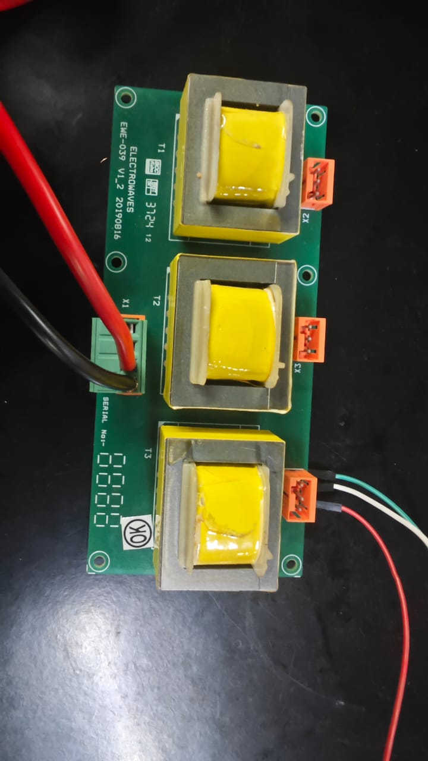
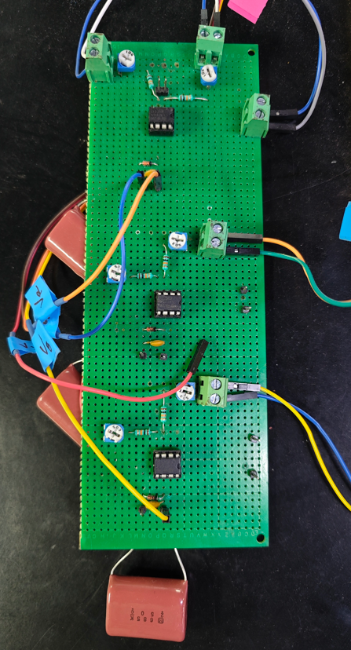
Components selection
Sensor selection
I use a transformer to decrease the voltage from 230 V RMS to approximately 13 V RMS.
Since the STM32 microcontroller requires the input voltage to be within the 0 to 3.3 V range, the stepped-down voltage needs further adjustment.
To make the voltage compatible, I first upshift the AC voltage so it remains positive.
Then, I scale the upshifted voltage to fit within the 0 to 3.3 V range.
This adjusted signal is fed into the STM32 microcontroller’s ADC for accurate voltage sensing.

Slide 11
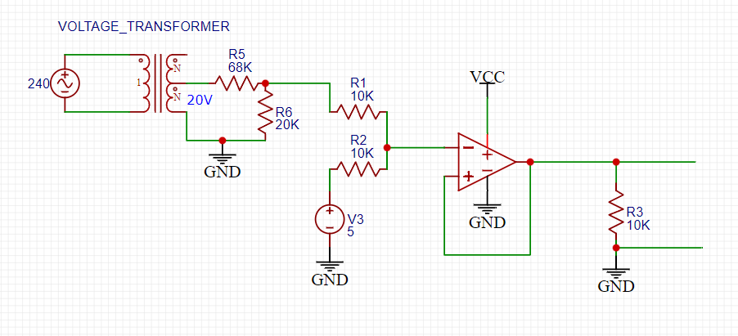
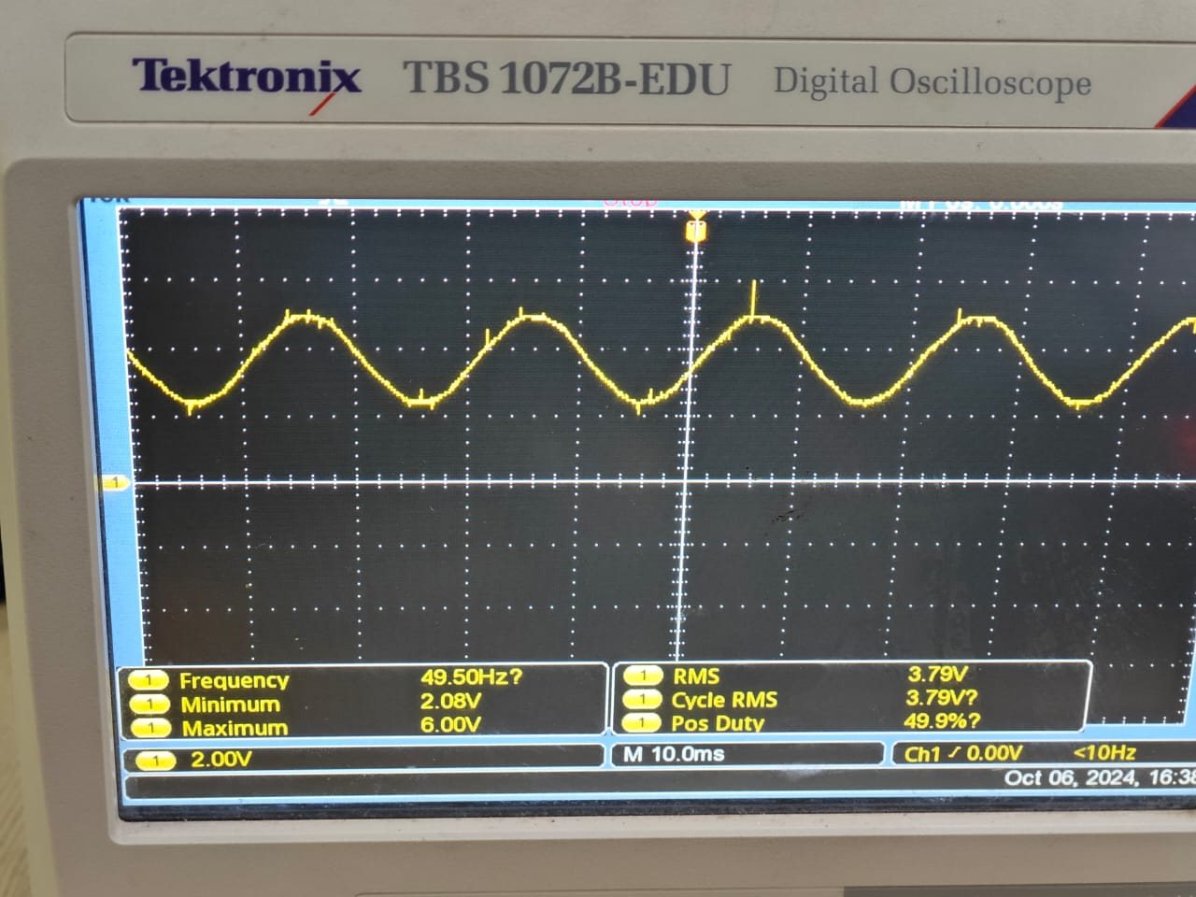
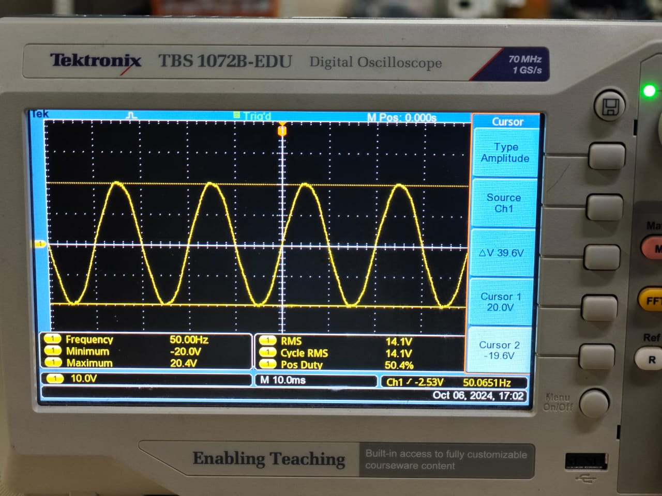
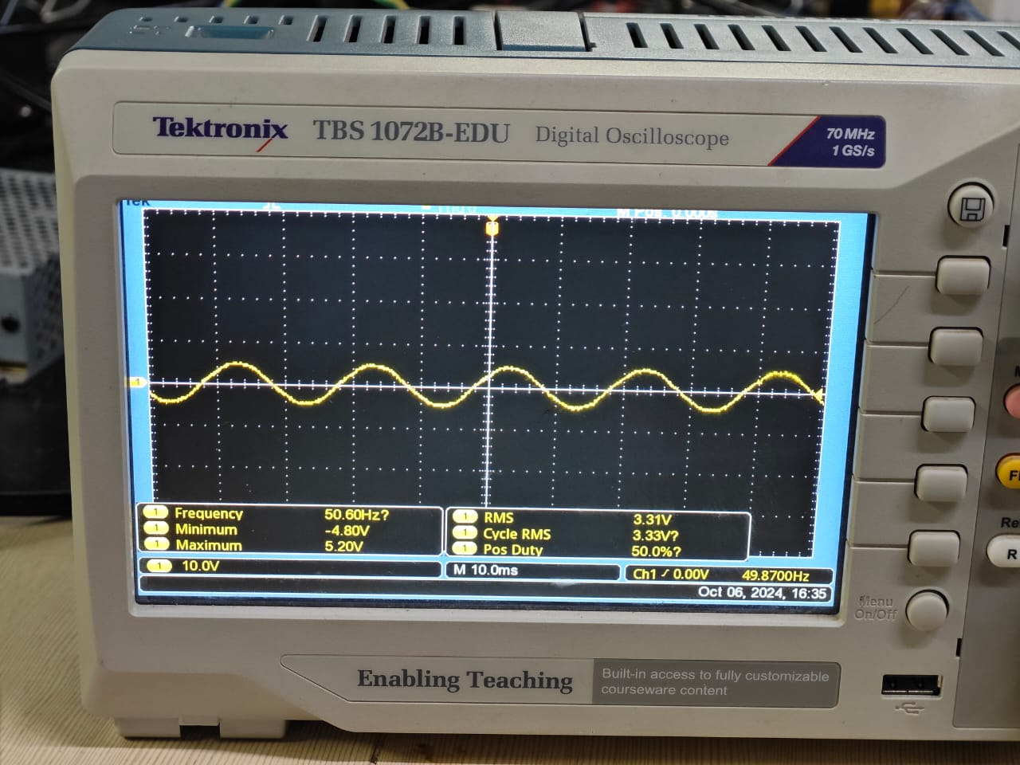
Components selection

Slide 12
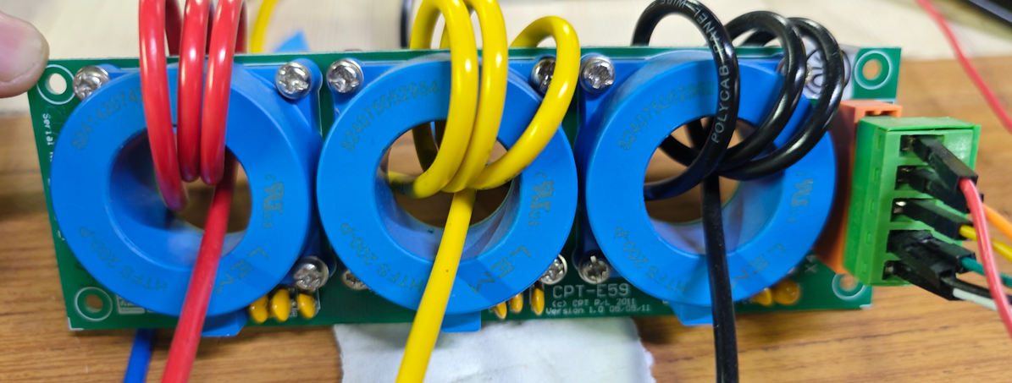
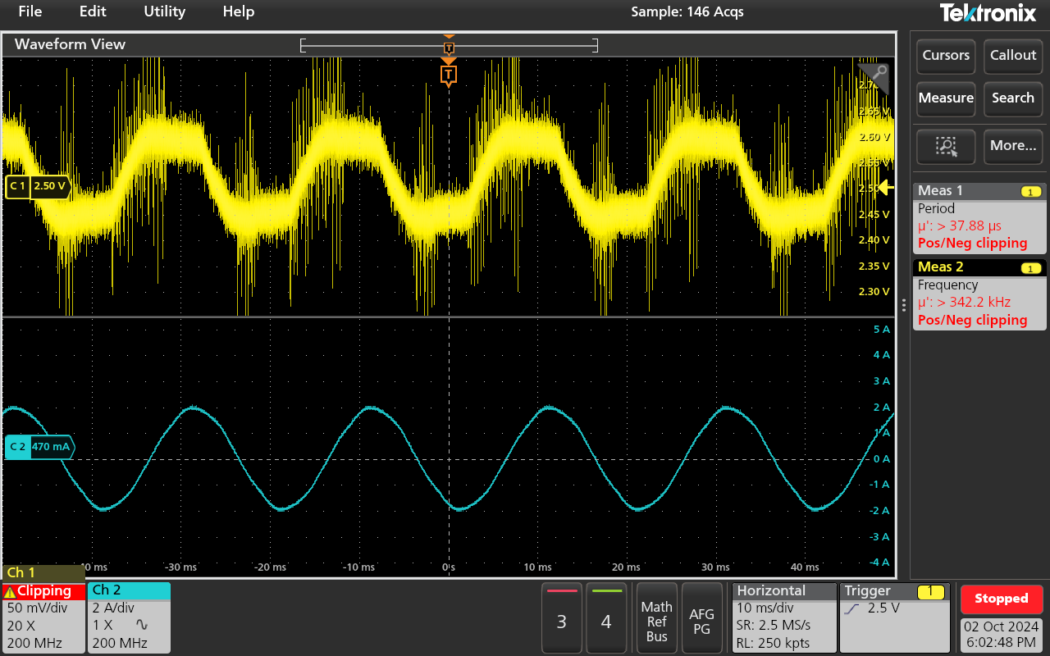
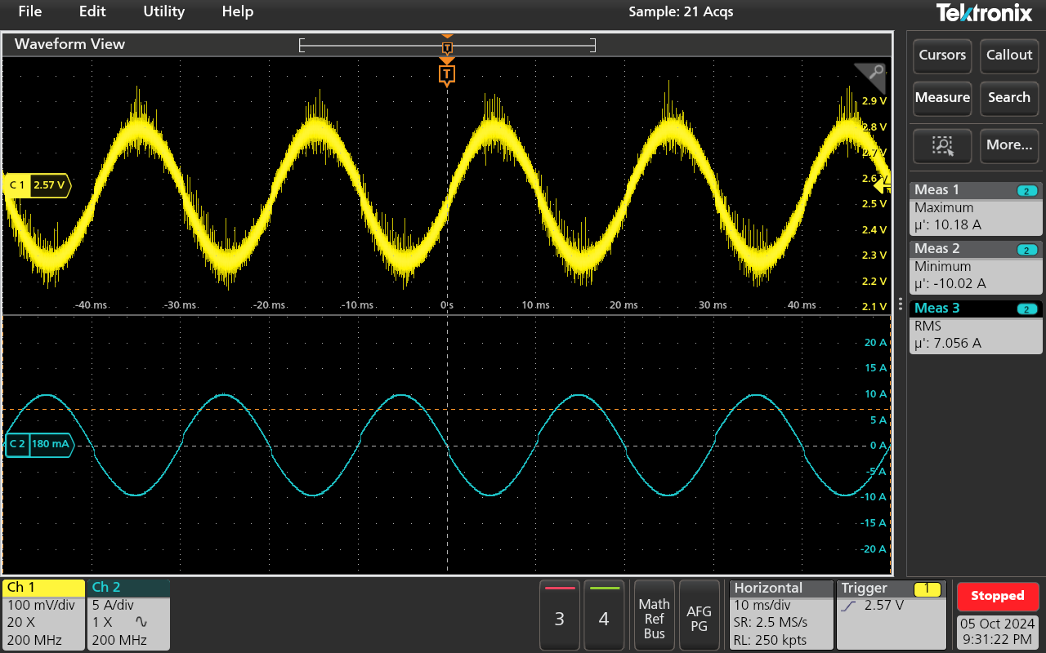
Components selection
Current sensor selection
I plan to use the HTFS 200 P current sensor from our lab, as it can sense currents up to 200 A and provides a voltage output in the range of 0 to 5 V with a 2.5 V reference base.
During testing, I observed that the sensor was very noisy and did not provide a proper output when measuring lower currents.
To improve accuracy, I wound the conductor three times through the sensor, which significantly improved the output quality compared to the initial results.

Slide 13
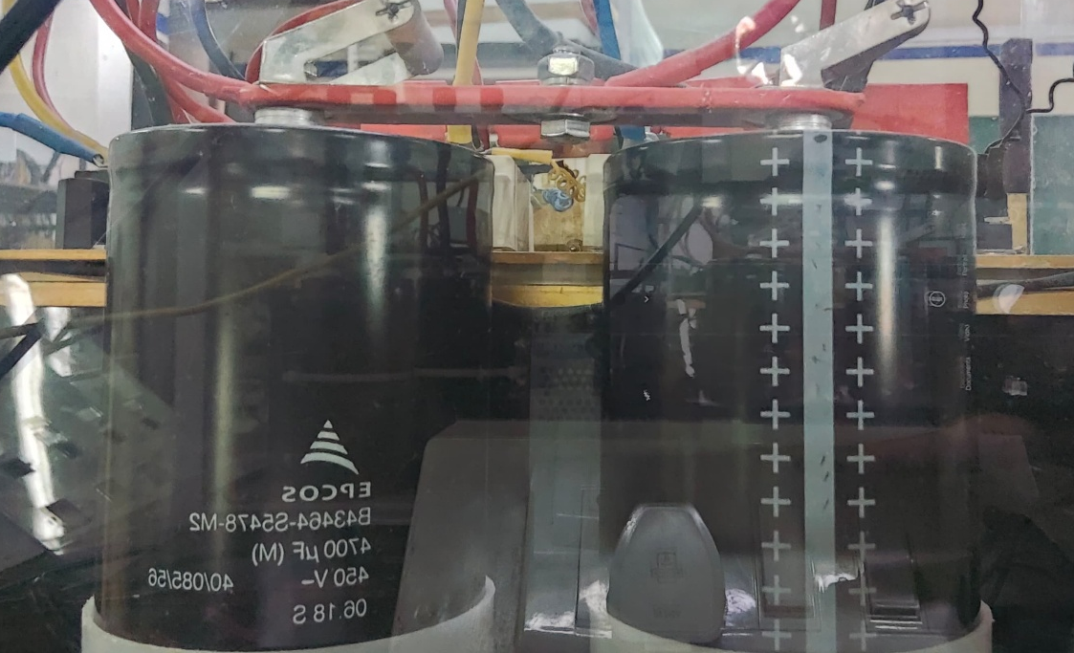
Components selection
DC link capacitor selection
I am using two 450 V, 4700 µF capacitors connected in series as the DC link capacitance.
This configuration allows the system to support up to 900 V DC input while maintaining reliability.
The effective capacitance of the series combination is 2350 µF.
The midpoint of these capacitors is used to create a star connection for the circuit.

Slide 14

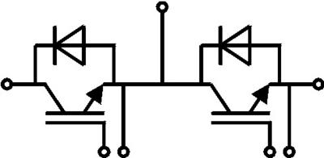
Components selection
IGBT selection
I am using a half-bridge IGBT module for the inverter.
The Absolute Maximum Ratings of the IGBT are:
VCES: 1200 V (Collector-Emitter Voltage).
IC: 88 A (Collector Current).
VGES: -20 V to 20 V (Gate-Emitter Voltage).
Switching Frequency: Up to 20 kHz.
Icnom: 75 A (Nominal Collector Current).
The inverse diode within the IGBT module has a forward current rating (IF) of 75 A.

Slide 15
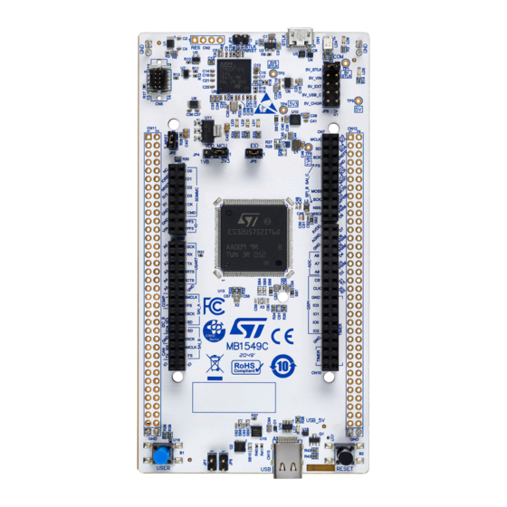
Components selection
Controller selection
The STM32H723ZG microcontroller is based on the ARM Cortex-M7 core.
It features a 32-bit processor with a clock frequency of 550 MHz.
The microcontroller has high-speed ADCs (Analog-to-Digital Converters) for precise signal measurement.
It supports PWM (Pulse Width Modulation) generation capabilities.
The microcontroller controls the switching sequence of IGBTs using SPWM (Sinusoidal PWM) or SVPWM techniques.
It handles feedback signals such as voltage and current, enabling closed-loop control.

Slide 16
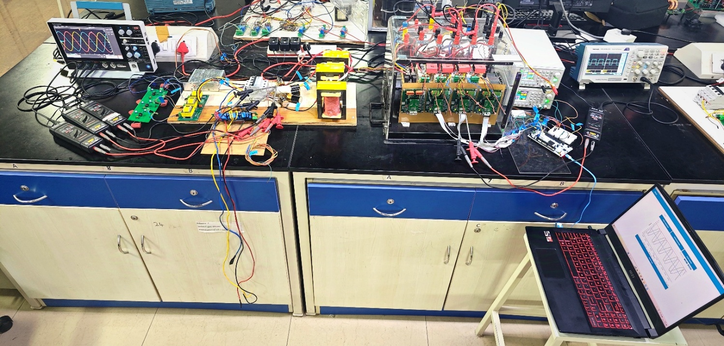
Hardware Implementation
Inverter Setup

Slide 17
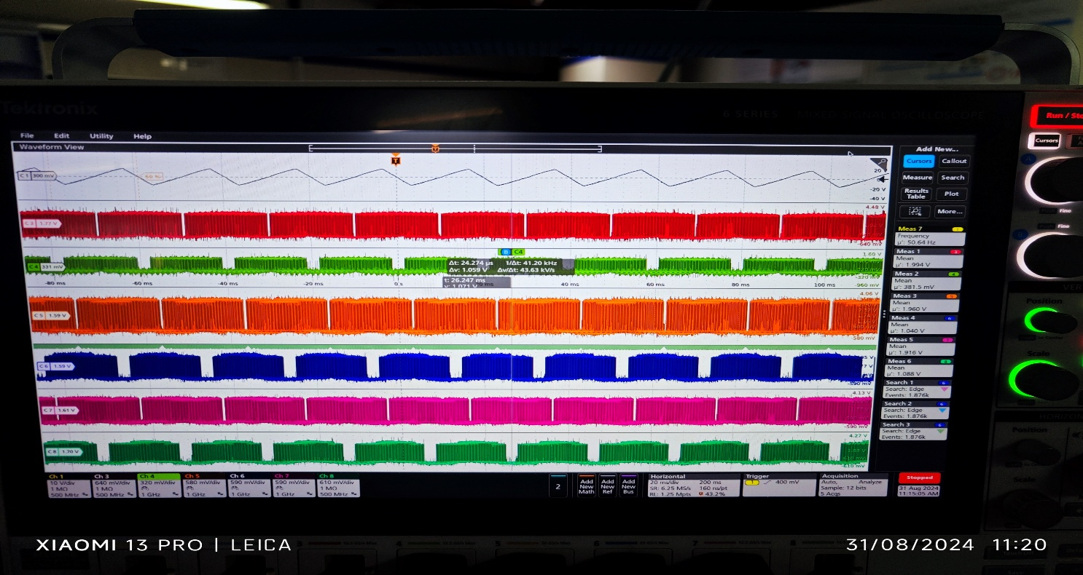
Hardware Implementation
Problems and solutions
During initial testing, the PWM signals generated from the STM32 microcontroller board were verified.
The dead time for each alternating or inverting channel output was carefully observed.
After confirming the signals appeared as expected, the DC supply was connected to the inverter.
The filter was connected, along with the R, Y, and B phases of the output.
However, the resulting output waveform was not as expected; instead of a sinusoidal waveform, a triangular waveform was observed.
Upon analyzing the SPWM signals generated by the STM32 microcontroller, it was found that Channel 1's inverting pin was providing a very low voltage-level gate pulse.
This indicated an issue with the gate signal.
Three-Phase SPWM and Output voltage Waveforms

Slide 18
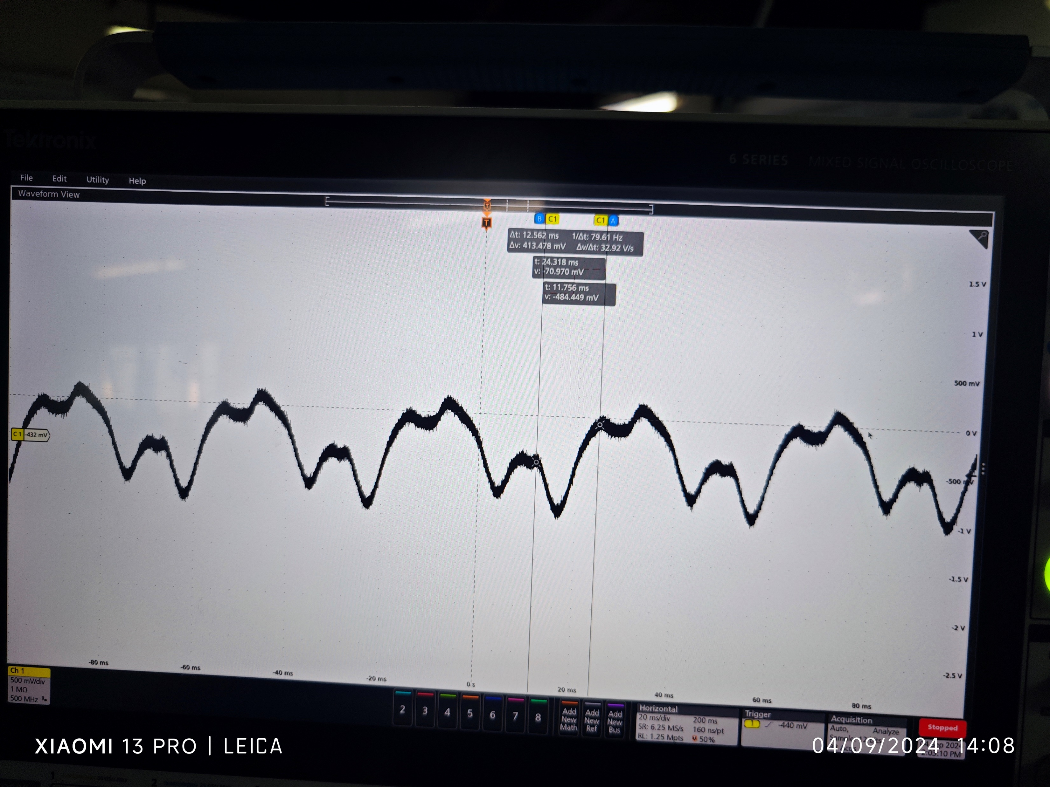
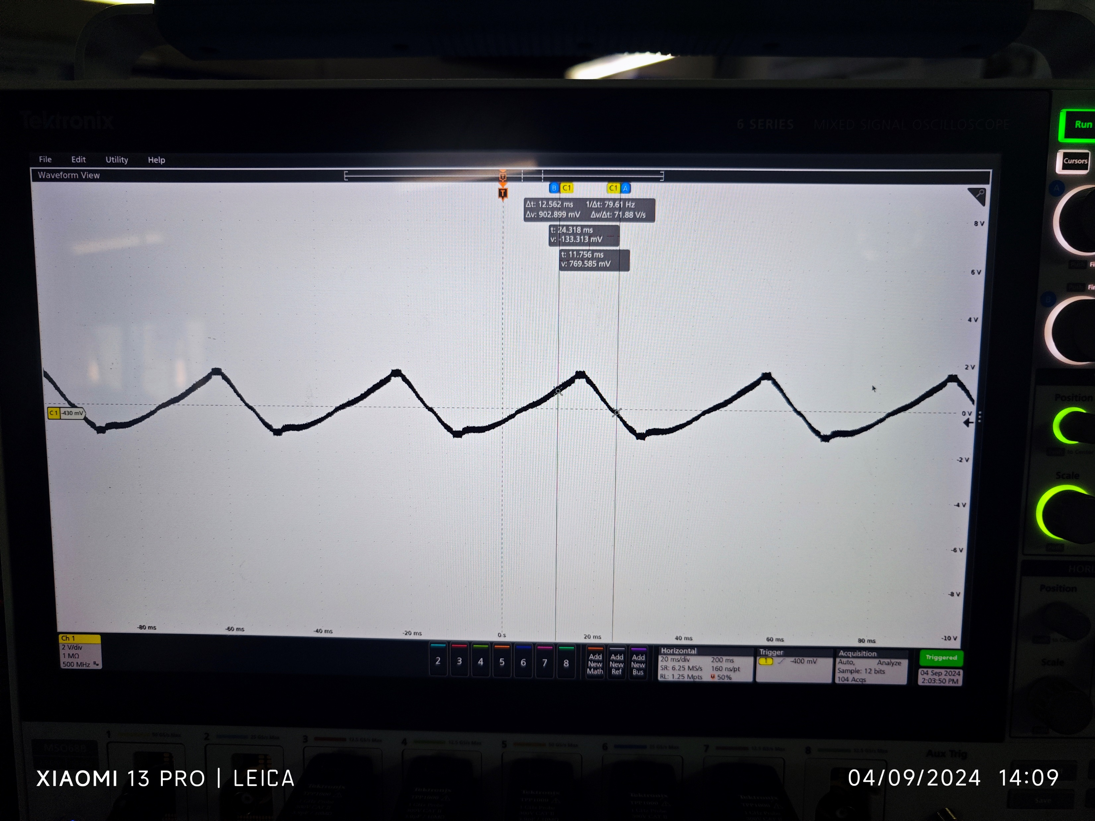
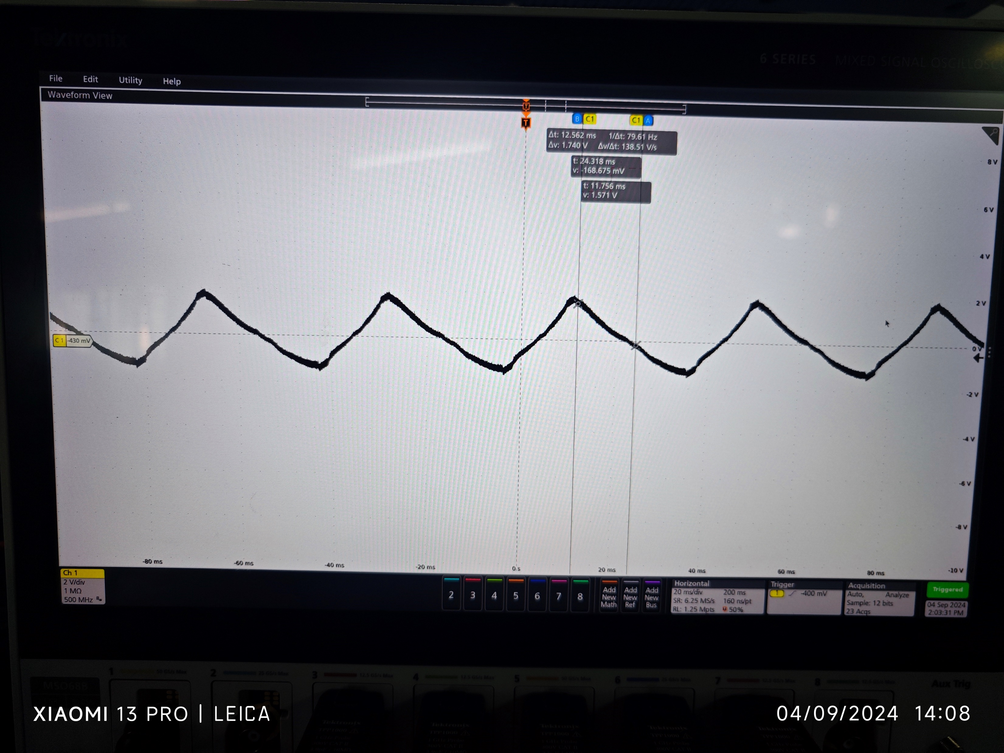
Hardware Implementation
Another STM32 microcontroller board was tested, but the problem persisted.
The fourth leg of the inverter was used as an alternative configuration, but the same triangular waveform was observed.
A small component between the gate driver input and the SPWM signal source was identified and replaced, but the waveform remained unchanged.
The issue indicated that the root cause was deeper, requiring further investigation into signal integrity and gate driver performance.
A star connection was made at the capacitors, and waveforms between each phase and the neutral point were analyzed.
One of the phases was significantly different compared to the other phases, and it was connected to Channel 1 Inverter Pin PA7 of the STM32H723ZG microcontroller.
Figure: 4.2.3 (b) Three-Phase Output Voltage Waveforms (R,Y,B)

Slide 19
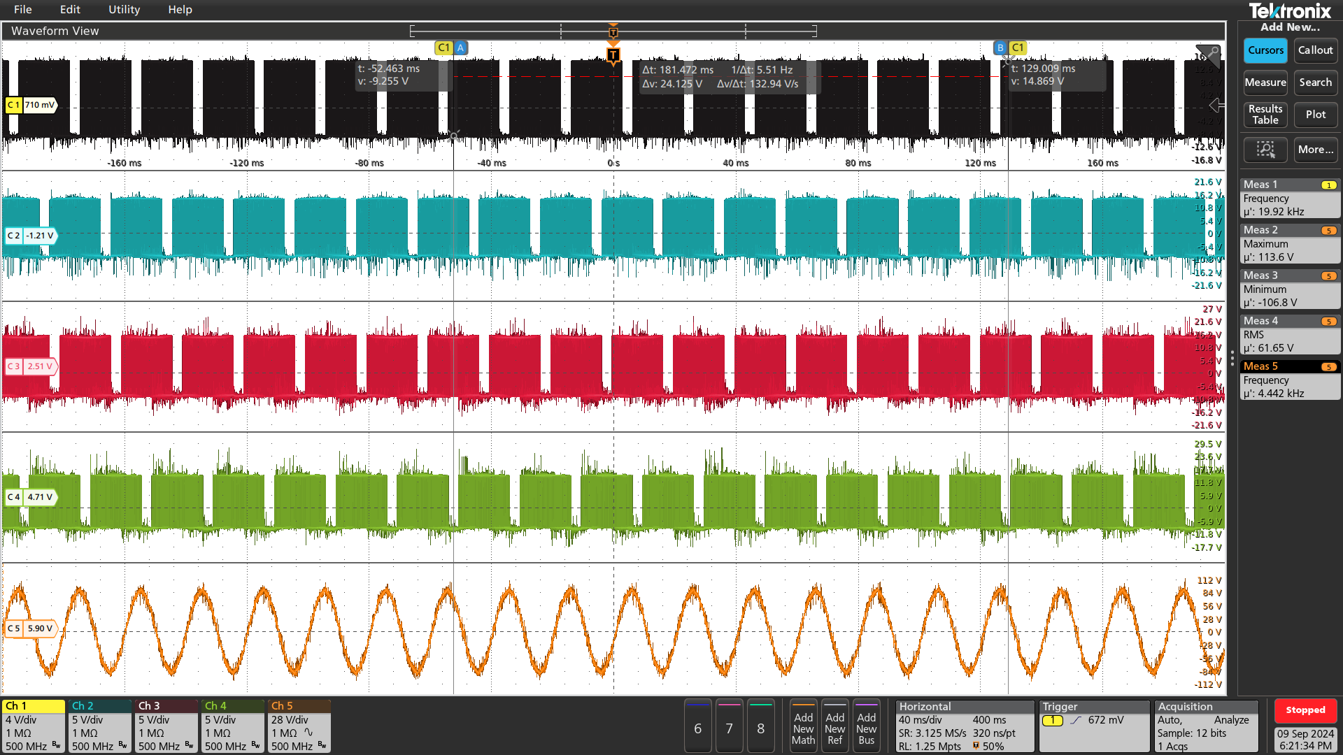
Hardware Implementation
This pin was providing lower voltage-level gate pulses, and even after replacing the STM32 board, the issue remained consistent.
The decision was made to change the Channel 1 Inverter Pin from PA7 to PE9, resulting in a much better sine wave output.
The problem was traced to the PA7 pin, which is interlinked with other internal functionalities of the STM32H723ZG, interfering with PWM pulse generation.
This interference caused the output gate pulses to be unstable and unreliable.
After switching to PE9, the PWM pulses improved, and the output waveform achieved the desired sine wave characteristics.
Figure: 4.2.3 (c) Three-Phase SPWM and Output Voltage Waveforms (R, Y, B)

Slide 20
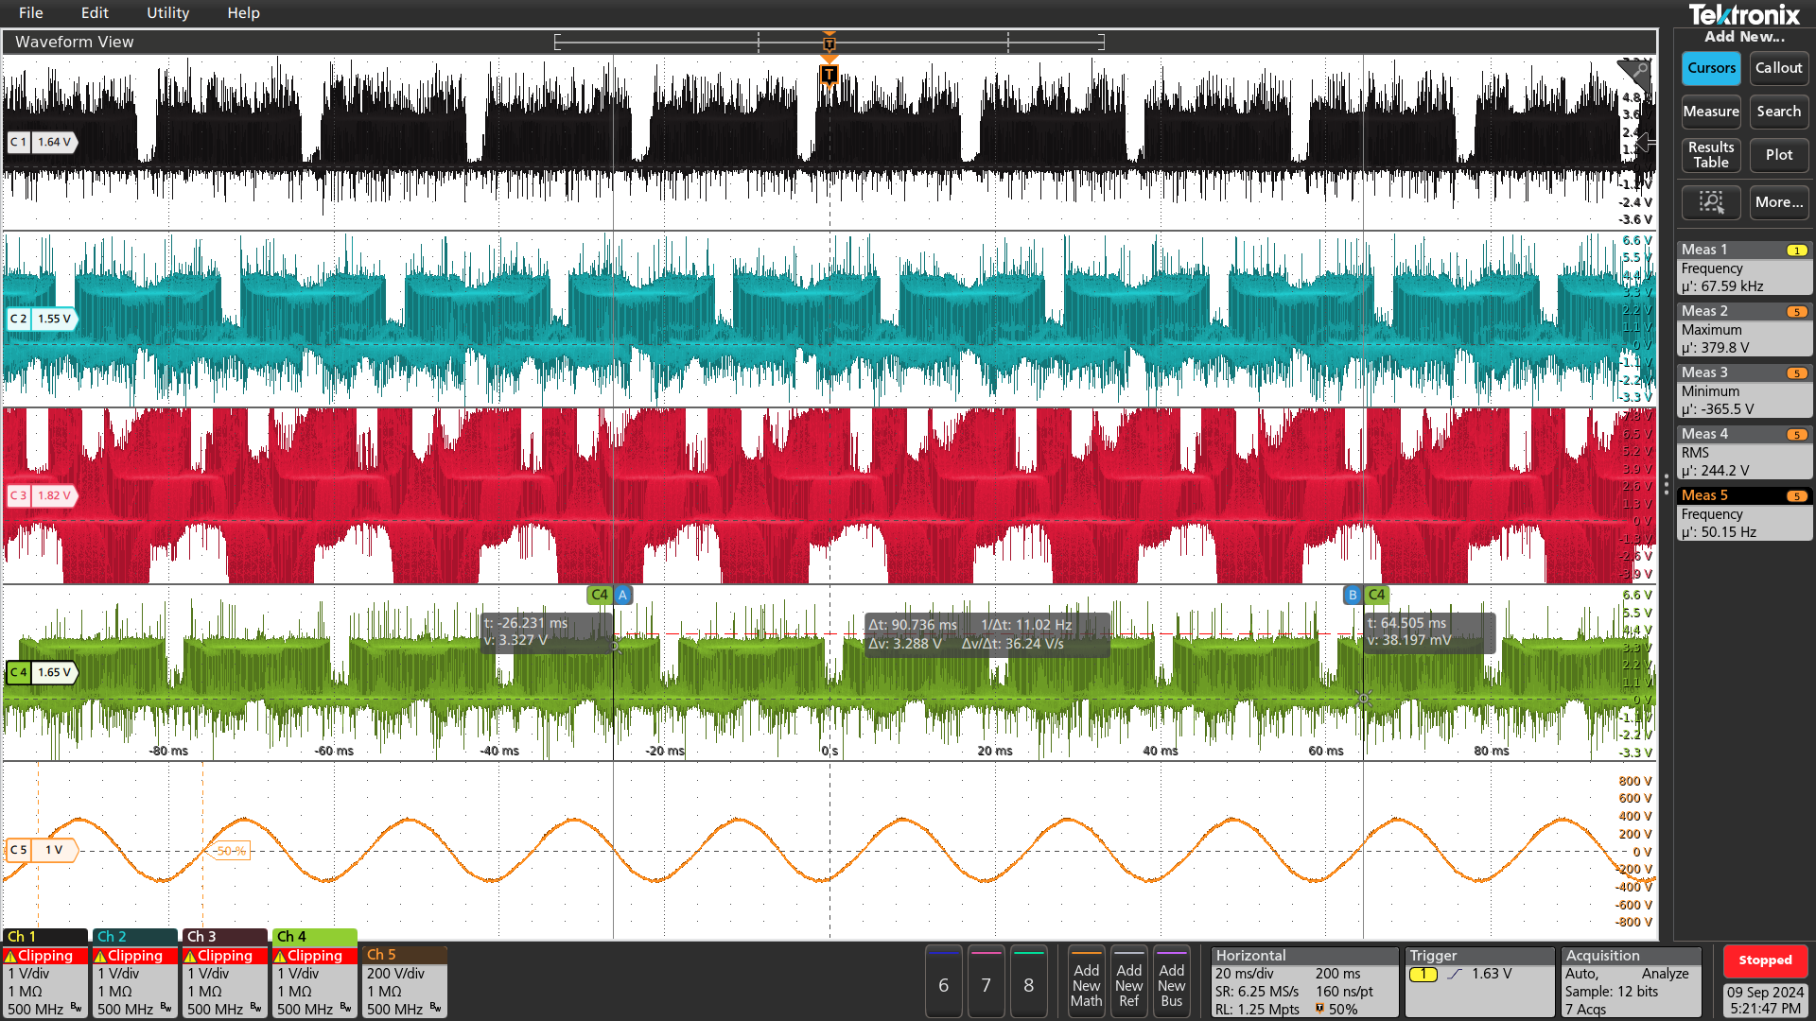
Hardware Implementation
When operating the inverter at higher voltage levels, significant disturbances occurred in the PWM pulses generated by the microcontroller.
The disturbances caused waveform instability and distortion in the output signals.
The PWM pulses deviated from their expected form, failing to maintain consistency and leading to unreliable inverter operation.
The primary cause of the disturbance was interference or noise introduced at higher voltage levels.
This noise impacted the stability of the gate drive signals, disrupting the precise timing and synchronization needed for accurate PWM signal generation.
The distorted PWM pulses are shown in the following figure, highlighting the deviation from the expected waveform.
This issue affected the inverter's efficiency and functionality, necessitating careful analysis to identify the source of the disturbance.
Figure: 4.2.3 (d) Three-Phase SPWM pulses at higher voltages

Slide 21
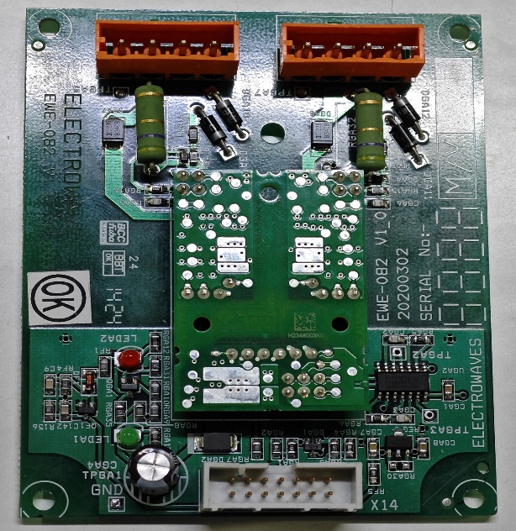
Hardware Implementation
We thought the problem might be with the drivers in the inverter stack, as they might not work well at higher voltage levels.
To fix this, we decided to try replacing the current drivers with ones that are better suited for high-voltage conditions.
These new drivers are designed to give more stable and reliable signals to the gates.
We hoped that using these new drivers would reduce the noise and interference affecting the PWM pulses.
The goal was to make the system more stable and ensure the inverter works properly, especially at higher voltage levels.
New Half Bridge Drives

Slide 22
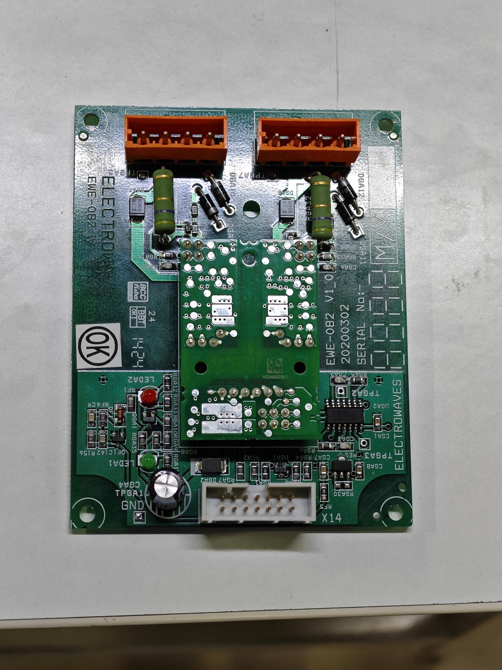
Hardware Implementation
We connected the SPWM pulses to the input of the new drivers and provided an auxiliary voltage of 15V.
The output pins were connected to an oscilloscope to check the signals, but no pulses were observed initially, even though the input was correct.
We double-checked all the connections between the output pins to ensure they were wired properly.
After extensive troubleshooting, we contacted the manufacturers for clarification.
They explained that the driver has a feature that prevents the output from activating unless it is connected to an IGBT switch.
This design ensures the driver operates only when properly connected to a load, like an IGBT, which is crucial for the inverter's proper functioning.
After checking the connectivity and giving small inputs we configured the pins.
Once the driver was connected to the IGBT, the output pulses were generated as expected.
Top Switch
Bottom Switch
E,G,_,C
E,G,_,C
BP,TP
15 v input
NC
GND
Figure: 4.2.3 (f) New Half Bridge Drivers pins

Slide 23
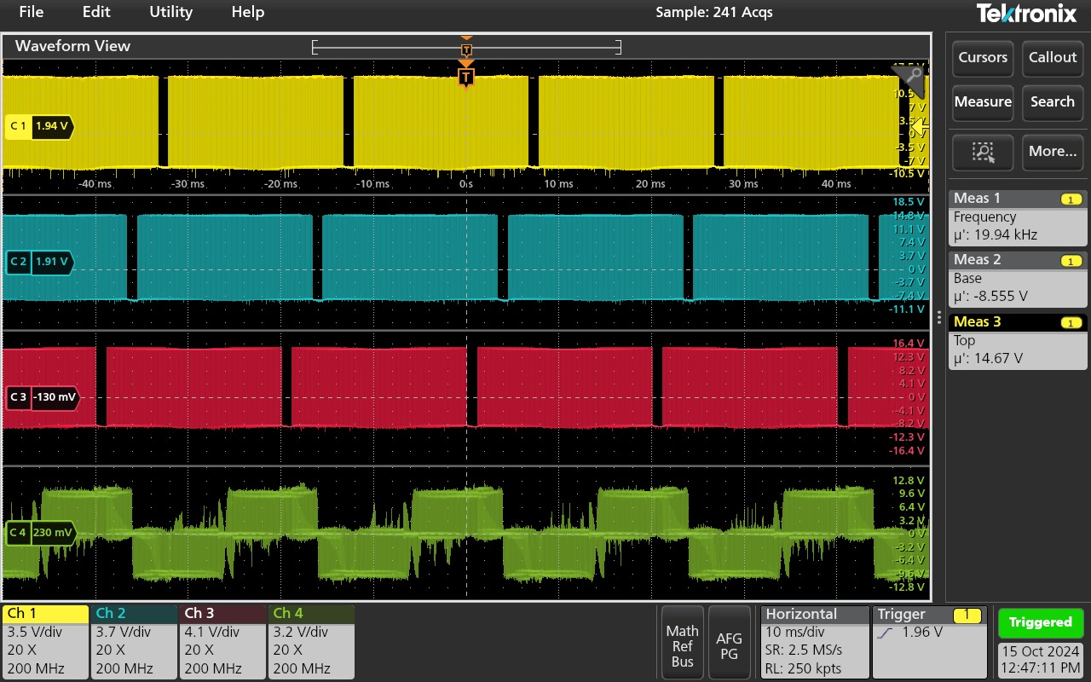
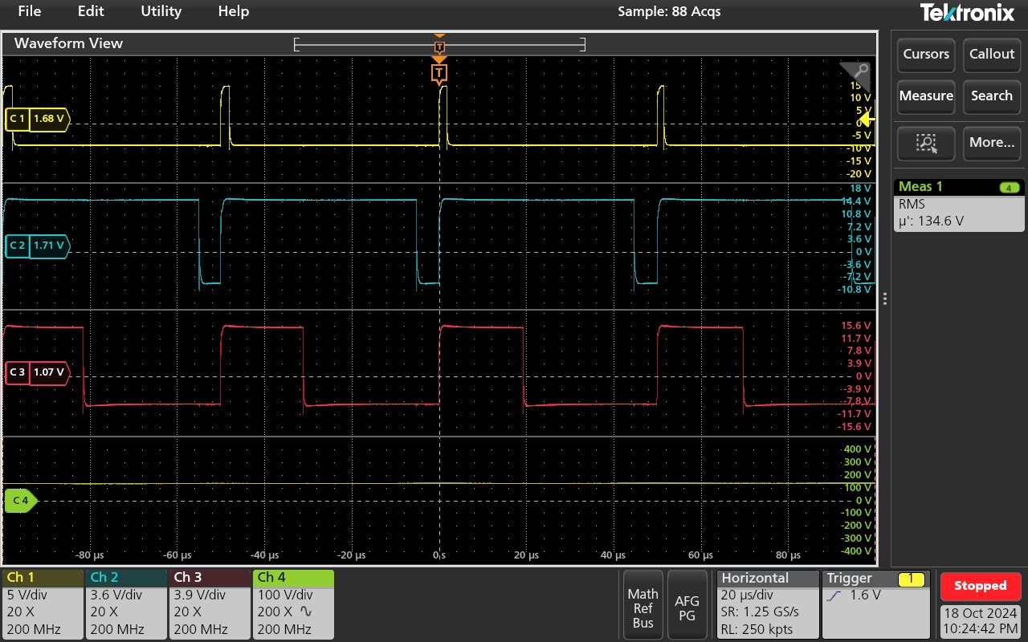
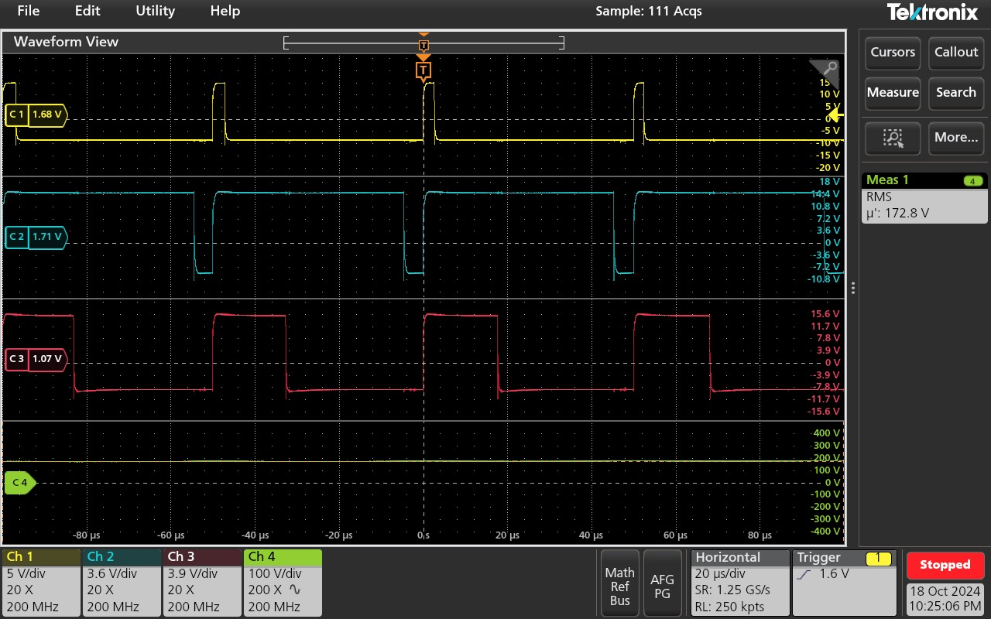
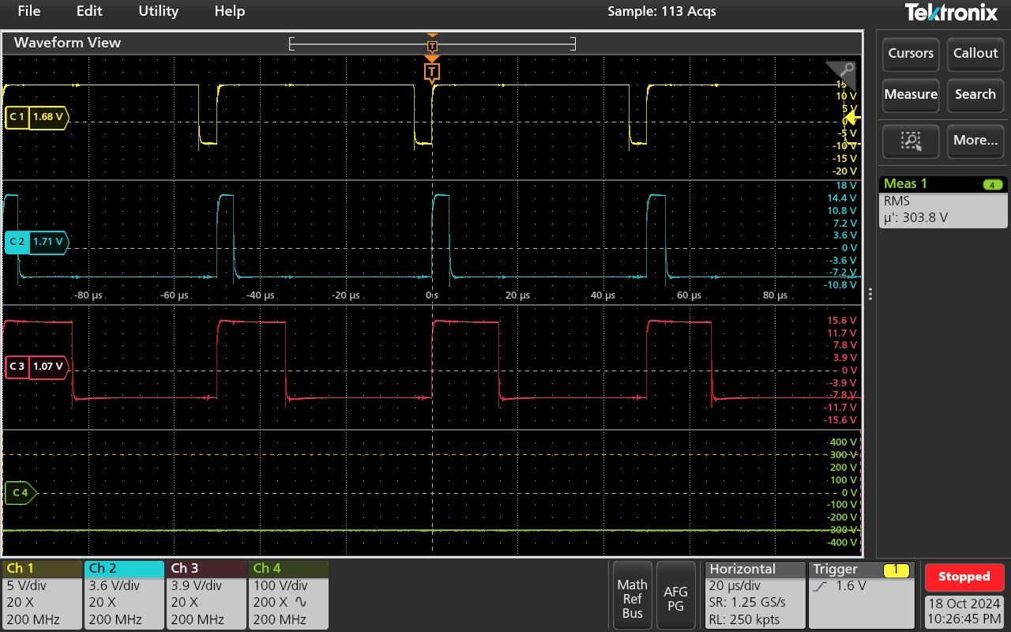
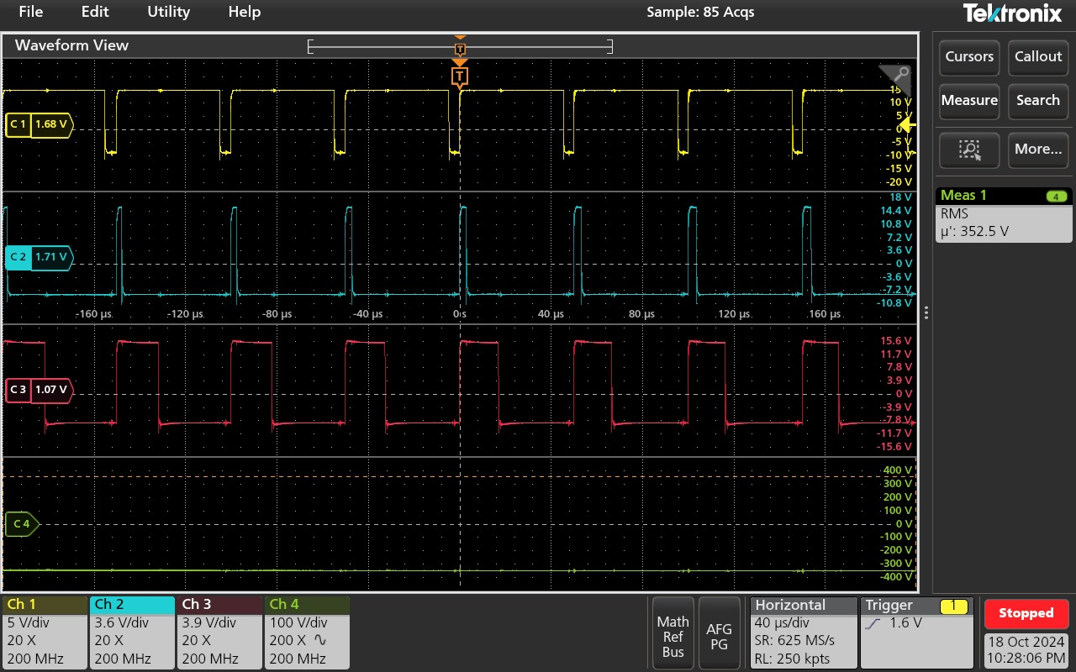
Hardware Implementation
New Half Bridge Driver Output
New Half Bridge Driver Output at High Voltages

Slide 24
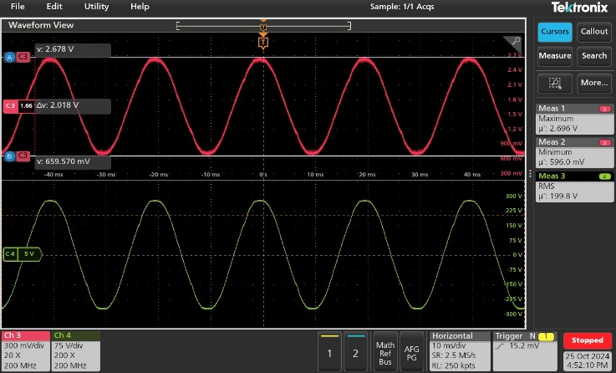

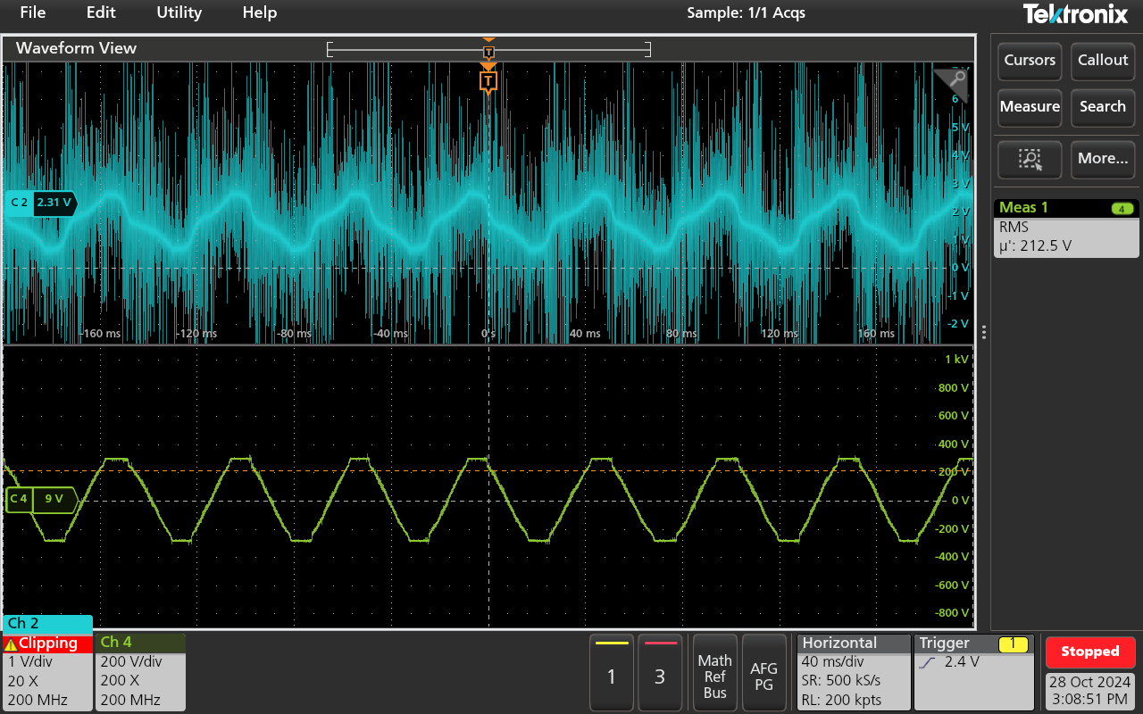
Hardware Implementation
The voltage sensing circuit was first tested with grid voltages, and the output appeared smooth and noise-free.
When the sensor was connected to the inverter's output for voltage feedback, the output became highly noisy and showed significant interference.
Further investigation revealed that the inverter's output contained 10 kHz frequency components, which caused the noise in the feedback signal.
The noise became worse when stepping down the voltage from +18V/-18V to +1.5V/-1.5V using potentiometers.
Reducing the voltage levels increased the noise, likely due to improper filtering or the voltage sensing circuit's sensitivity to high-frequency components.
The increased noise created difficulties in obtaining clean and stable voltage feedback for the control system.
Figure: 4.2.3 (i) Voltage sensing circuit output when connected to Grid
Voltage sensing circuit output when connected to inverter output

Slide 25
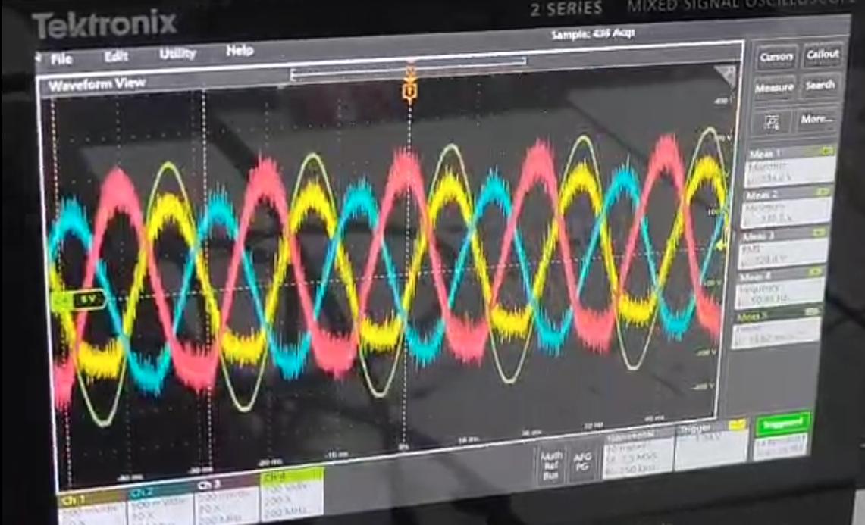
Hardware Implementation
The SPWM was modified to produce a proper sine wave, reducing harmonic distortion and improving the inverter output's waveform quality.
A 6.85 µF capacitor was added before the ADC pins of the STM32 microcontroller to act as a filter.
The capacitor smoothed out high-frequency noise and reduced sharp voltage spikes, stabilizing the voltage sensing circuit.
The ground of the voltage sensing circuit was connected to the STM32's AGND (Analog Ground) instead of the normal ground.
This change minimized ground loop issues and provided a better reference voltage for the ADC, improving voltage sensing accuracy.
These adjustments significantly reduced noise, as shown in the improved voltage sensing results.
Voltage sensing circuit output when connected to inverter after modifications output

Slide 26
Software Implementation
The first major task in software implementation was developing features for generating a Sine Pulse Width Modulation (SPWM) signal to drive the inverter at a switching frequency of 10 kHz.
This involved setting up multiple ADCs, DMA, and interrupts for tasks like ADC conversion complete, timer interrupts, and SPWM lookup table generation.
Timer 1 on the STM32H723ZG microcontroller was used to achieve the 10 kHz switching frequency.
The STM32H723ZG operates with a clock frequency of 550 MHz, and the timer clock was set to 275 MHz by setting the prescaler to 0.
The Counter Period (ARR) and CCR (Capture/Compare Register) were calculated for the PWM frequency:
Counter Period (ARR) = Timer clock / PWM frequency = 275 MHz / 10 kHz = 2750
CCR (Duty cycle) = Duty cycle * Counter period
A 50 Hz sine wave was required, with a time period of 0.02 seconds.
Given the 10 kHz switching frequency, the duty cycle can be updated every 0.0001 seconds (0.1 milliseconds), resulting in 200 samples per sine wave cycle.
The number of samples for the SPWM was calculated as:
Time Period (SPWM) = 1 / 50 Hz = 0.02 seconds
Switching Frequency = 10 kHz (time period = 0.0001 seconds)
Number of samples for SPWM = 0.02 seconds / 0.0001 seconds = 200 samples.

Slide 27
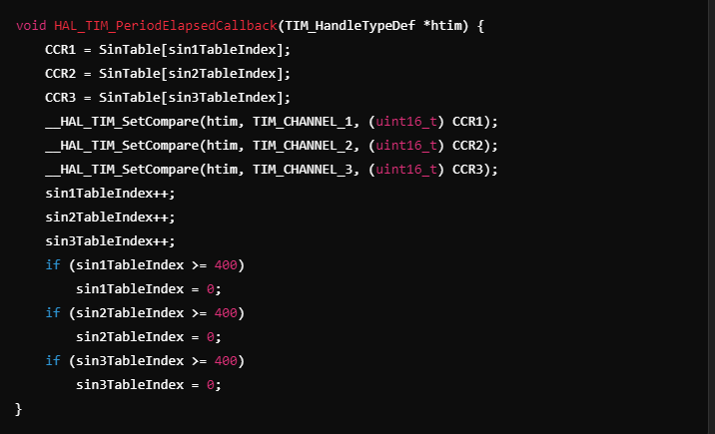
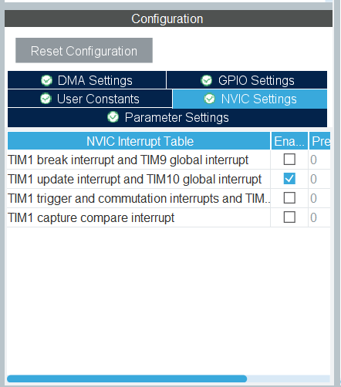
Software Implementation
In the STM32 firmware, we used Timer 1 to generate the PWM signal, updating the CCR values according to the sine table. This was done in the timer interrupt callback function:
Despite the efforts to implement the SPWM, the signal was not being generated as expected. After debugging, we identified that the timer interrupt was not being triggered, which was the reason the SPWM was not being updated. Upon further analysis, have found that it is not entering into the timer elapsed block.
Further analyzing I understand that I didn’t enable the Timer1 global interrupt.
Timer Interrupt Enable

Slide 28

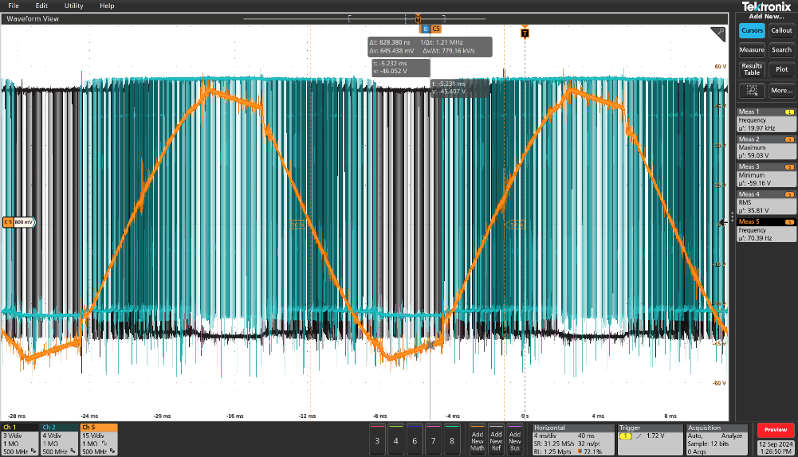
Software Implementation
Initially, the output of the sine wave was saturating at the top and bottom points, where the duty cycle reached its maximum and minimum values. This saturation occurred because the maximum duty cycle was being applied at the peak points of the sine wave, causing the signal to clip. The figure below shows that the output couldn’t smoothly follow the sinusoidal waveform at these points.
This issue likely stemmed from improper scaling or clamping of the duty cycle at the extremes of the sine wave. To resolve this, we need to ensure that the duty cycle is correctly adjusted throughout the sine wave, preventing it from exceeding the limits and avoiding the saturation effect
To generate the SPWM, we created a lookup table with 200 samples representing a sine wave. The lookup table generation process involves calculating the sine values for each phase with 120-degree shifts to create a three-phase SPWM. These sine values were then scaled to fit the required voltage range, and the values were rounded to integers for use in the PWM registers. The lookup tables were generated using Python and saved as text files to be used in the STM32 firmware.
SPWM Lookup Table Generator
Saturated sinewave

Slide 29
Software Implementation
To address the issue, maximum and minimum duty cycle limits were implemented to prevent saturation at the top and bottom of the sine wave, where the duty cycle reaches its extremes.
This prevented clipping at the extremes and ensured the duty cycle stayed within the expected range.
The SPWM signal was scaled according to these limits to achieve smoother transitions between the peaks and troughs of the sine wave.
Dead-time management was introduced to synchronize the switching signals more effectively.
This resulted in a more stable and accurate sine wave output without saturation, improving overall waveform quality.
The dead-time setting is an 8-bit value, ranging from 0 to 255, and it configures the dead time duration based on the timer input clock.
For a minimum of 3 µs dead time, the calculated value for STM32H723ZG is 244.

Slide 30
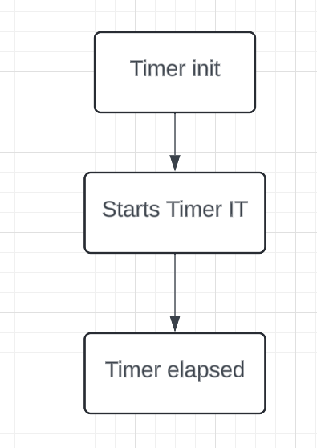
Software Implementation
Initially, the polling method was used for ADC conversion to read values from multiple channels.
This method worked well for initial testing and simpler tasks.
As the project advanced, particularly with the implementation of closed-loop control and additional features, system performance started to degrade.
Polling requires the CPU to continuously check the status of each ADC channel, which becomes time-consuming when handling multiple channels or high-frequency sampling.
As the system became more complex, this approach started slowing down the overall process, especially the timer interrupts.
Timer interrupts were crucial for PWM generation and inverter control, but they began to be delayed due to the time consumed by the polling method.
void HAL_TIM_PeriodElapsedCallback(TIM_HandleTypeDef *htim) {
// checking whether the elapsed timer is TIM1 or not
if (htim->Instance == TIM1) {
// configuring ADC for sensing Vr
ADC_ForVoltageR();
HAL_ADC_Start(&hadc1);
HAL_ADC_PollForConversion(&hadc1, 1000);
VOLTAGE_ADC_VALUES[0]=HAL_ADC_GetValue(&hadc1);
HAL_ADC_Stop(&hadc1);
// configuring ADC for sensing Vy
ADC_ForVoltageY();
HAL_ADC_Start(&hadc1);
HAL_ADC_PollForConversion(&hadc1, 1000);
VOLTAGE_ADC_VALUES[1]=HAL_ADC_GetValue(&hadc1);
HAL_ADC_Stop(&hadc1);
// configuring ADC for sensing Vz
ADC_ForVoltageB();
HAL_ADC_Start(&hadc1);
HAL_ADC_PollForConversion(&hadc1, 1000);
VOLTAGE_ADC_VALUES[2]=HAL_ADC_GetValue(&hadc1);
HAL_ADC_Stop(&hadc1);
}
Figure: 4.3.1 (d) ADC pollforConversion

Slide 31
Software Implementation
Transitioned to using DMA for ADC conversions to speed up data transfer and reduce CPU workload.
DMA allows ADC data to be transferred directly into memory, enabling the handling of multiple ADC channels simultaneously.
Encountered a problem where DMA transfers were not working correctly due to the lack of enabling "DMA circular mode" in the ADC parameter settings on the STM32H723ZG.
Enabling DMA circular mode resolved the DMA transfer issue and allowed continuous data collection from ADC channels.
After enabling DMA, another problem arose: ADC conversions were happening at a very high rate, causing the callback function to trigger too frequently.
This overloaded the system, slowing down critical timer interrupts used for PWM signal updates.
Reduced the ADC clock speed by dividing it by 4 to slow down the conversion rate and prevent overload, allowing timer interrupts to function properly.
The system became more stable after this adjustment, with the ADC values updating at a reasonable rate and without delays in timer interrupts.
Observed sudden spikes or fluctuations in ADC readings, leading to noisy data.
Implemented a Butterworth filter to reduce high-frequency noise and smooth out fluctuations in ADC values.
The Butterworth filter improved the stability of ADC values, reducing noise and spikes, resulting in more accurate and consistent data.
The filter enhanced system performance, ensuring more reliable operation, particularly for closed-loop control and other features.

Slide 32
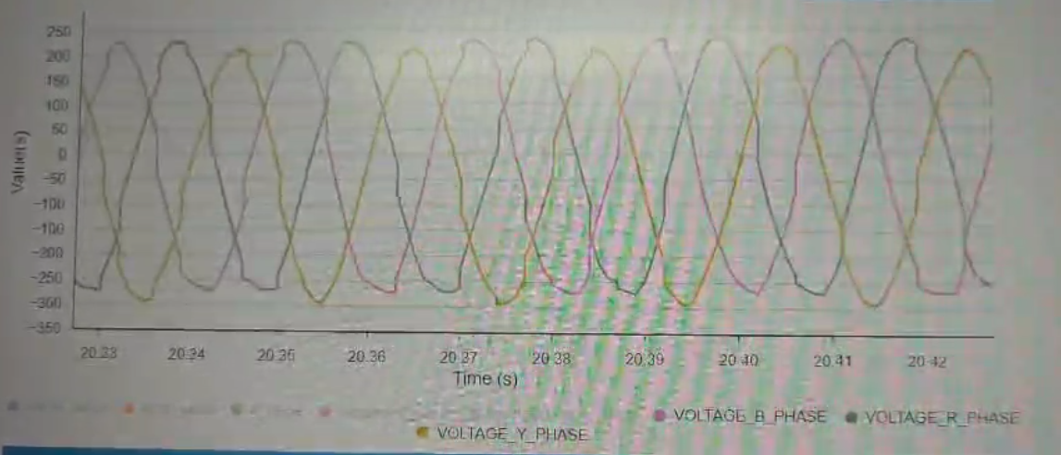
Software Implementation
Figure: 4.3.1 (e) Three phase ADC values

Slide 33
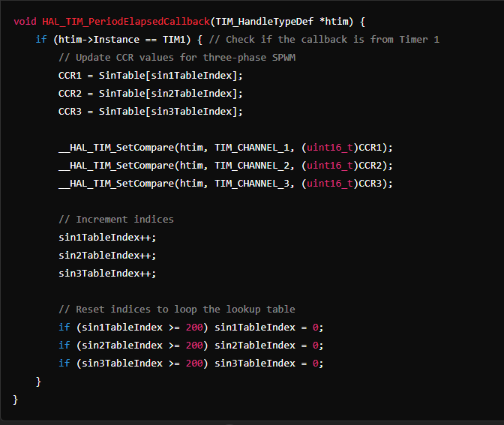
Open Loop Control
PWM signals are generated by updating the CCR values of the timer, controlling the inverter’s output voltage.
The timer runs at the required frequency (e.g., 10 kHz) and triggers a callback to update PWM signals.
A precomputed SPWM lookup table provides sinusoidal duty cycle values for PWM.
The CCR register is updated with values from the lookup table to control the PWM duty cycle.
On timer overflow, the callback function updates the CCR values to generate the PWM waveform.
The system generates sinusoidal PWM signals without feedback adjustments.
PWM signals control the inverter output, generating a sinusoidal waveform.

Slide 34
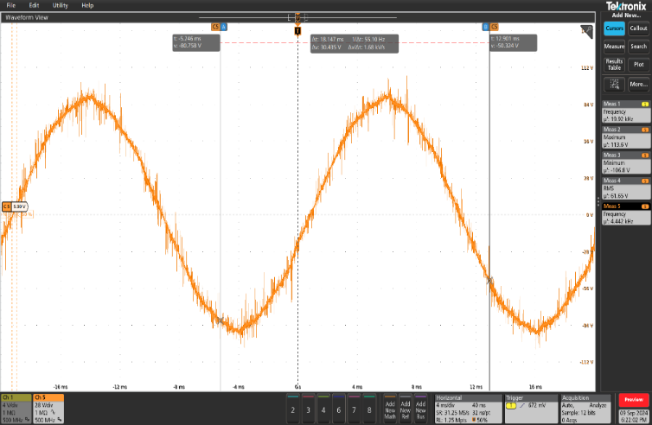
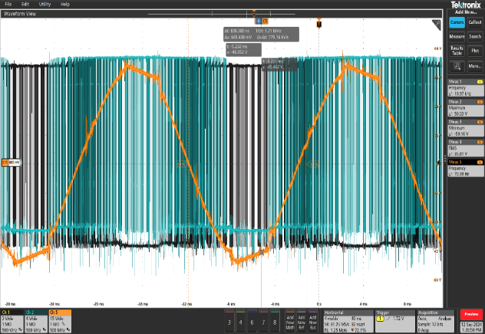
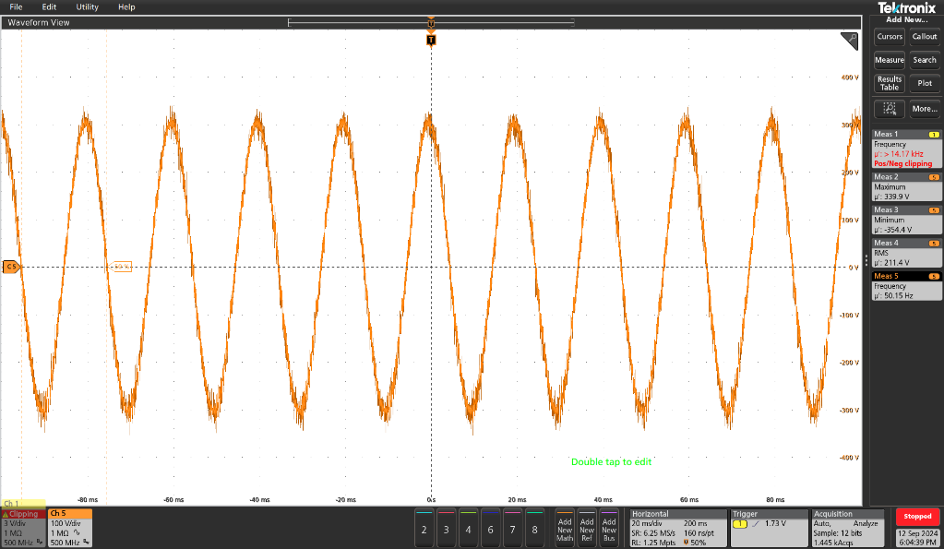
Open Loop Control
Initially, the open-loop system was tested without applying limits on the CCR values.
Without load:
The output voltage followed a sinusoidal waveform.
Peaks of the waveform directly corresponded to the PWM duty cycle’s full range.
Clipping occurred at high and low points as the duty cycle exceeded the valid range.
When a load was applied:
The voltage waveform improved and became more stable.
By implementing maximum and minimum limits on the duty cycle:
Clipping issues were avoided.
A smoother, better-quality sine wave output was achieved.
Overall inverter performance and stability improved.
open loop Without Load
open loop With Load
open loop Without Load when limits applied to CCR

Slide 35
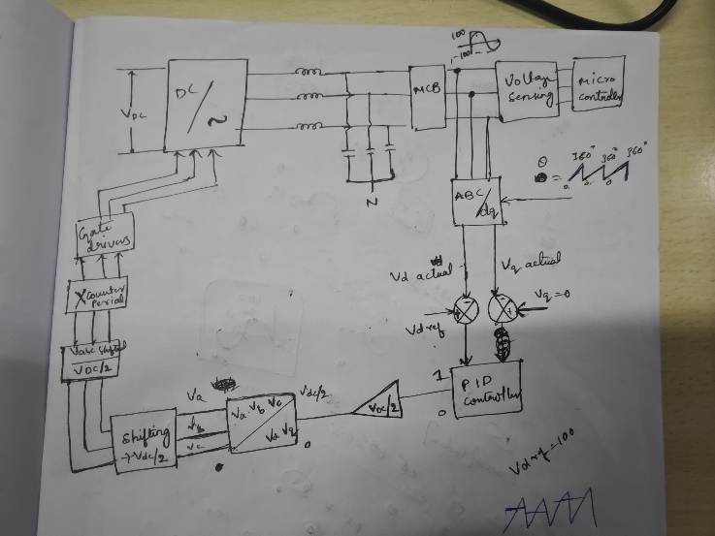
Closed Loop voltage Control
The main control loop handles the transformation and control of a three-phase voltage source.
It starts by updating the phase angle (theta) used for transformations.
The system reads the three-phase voltages (VOLTAGE_R_PHASE, VOLTAGE_Y_PHASE, VOLTAGE_B_PHASE) through ADC inputs.
The abc_to_alpha_beta function is used again to transform the three-phase system into the alpha-beta stationary reference frame, simplifying the control logic.
The alpha and beta values are stored in global variables for monitoring.
These alpha-beta components are then transformed into the rotating dq reference frame using the current phase angle (theta).
This aligns the d-axis with the reference vector, enabling easier control of active power.
A PID controller regulates the vd component (aligned with the d-axis), and the control output is scaled by half the DC bus voltage (VDC/2) to compute the controlled voltage (vd_control).
The vq component (aligned with the q-axis) is set to zero, assuming no reactive power control in this implementation.
The controlled dq components are then transformed back into the alpha-beta reference frame.
Finally, the system converts these alpha-beta components back into the original three-phase system using the alpha_beta_to_abc function.
The resulting values (vaControl, vbControl, vcControl) represent the voltage commands for each phase.
This control loop manages the transformation between reference frames and implements control strategies, ensuring synchronization with the grid or a reference signal while maintaining appropriate voltage outputs for the application.

Slide 36
Closed Loop voltage Control
The PLL algorithm is processed via the TIM8 interrupt, which operates at a higher frequency.
During each interrupt, the system reads three-phase inputs (a, b, c) through ADC.
The abc_to_alpha_beta function transforms these three-phase inputs into a two-axis stationary reference frame (alpha, beta).
This simplifies phase computation by projecting the system onto orthogonal axes while maintaining phase information.
The transformation uses a weighted linear combination of the three phases to generate the alpha and beta components.
The alpha and beta values are passed to the PLL_Update function.
Here, the phase error is calculated by comparing the reference signal with the estimated phase angle (theta).
A PI controller processes this error to update the angular velocity (omega), representing the estimated frequency.
The phase angle (theta) is adjusted by integrating omega over time, keeping the value within the range of [0, 2π].
The updated phase angle is then used to transform the alpha and beta values into a rotating reference frame (d, q) using the alpha_beta_to_dq function.
This simplifies control tasks by aligning the d-axis with the reference signal.
Angular velocity is also converted into frequency (in Hz) for monitoring.
The process dynamically tracks the phase and frequency of input signals, ensuring synchronization for applications such as grid control.

Slide 37
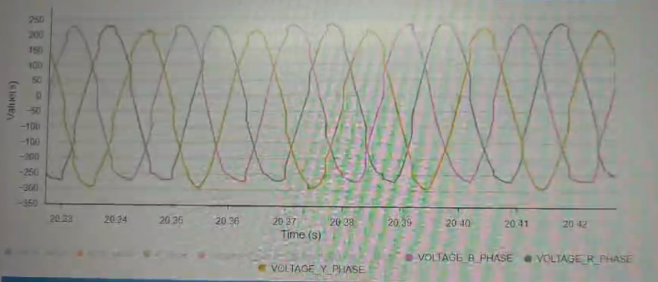
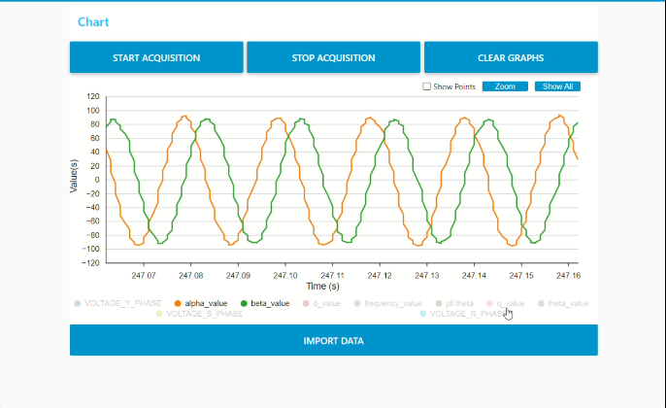
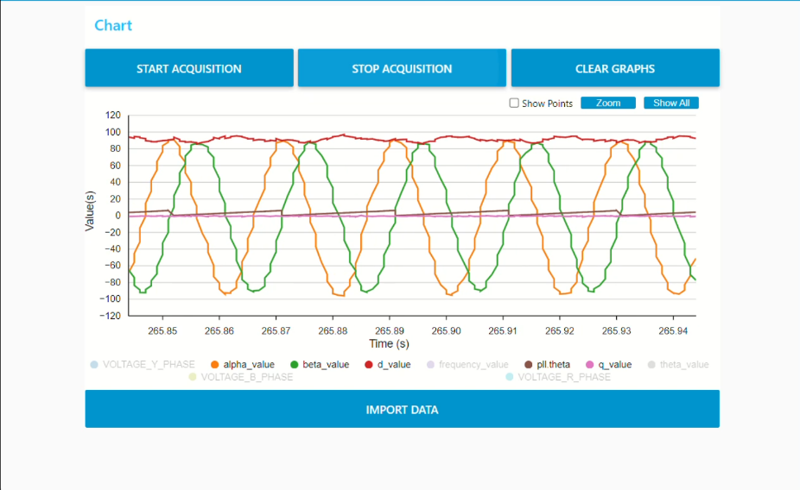
Closed Loop voltage Control
Figure: 4.3.3 (c) ABC to Alpha Beta
Figure: 4.3.3 (b) Alpha Beta to DQ

Slide 38
Grid Connected loop

Slide 39
Testing
Inverter Setup

Slide 40
Testing
The hardware setup was designed to comprehensively test the performance of the inverter and its associated control system. The setup began with a DC power supply, which provided the necessary DC voltage to the inverter stack. This power was crucial for driving the inverter, which converted DC to AC.
The STM32 microcontroller played a central role in the system by generating the PWM signals that controlled the switching behavior of the inverter. These PWM signals were sent to gate drivers, which acted as intermediaries between the microcontroller and the switching devices. The gate drivers controlled the IGBT half-bridge modules, which are responsible for switching the DC input voltage into AC voltage. The half-bridge configuration allowed for efficient switching of power and is a typical setup in inverter applications.
To ensure the AC output voltage was stable and free from high-frequency switching noise, the inverter output was connected to a load through an LC filter. The LC filter consisted of inductors in series and capacitors in parallel, which helped to smooth out voltage ripples and filter out high-frequency noise from the PWM switching. This resulted in a cleaner output voltage suitable for driving loads like motors or other equipment.
To provide protection for the system, the output was routed through a mini circuit breaker (MCB). The MCB ensured that in case of overcurrent conditions, the system would automatically disconnect, preventing damage to the inverter and other components.
For performance monitoring, several key measurements were taken. Voltage transformers were used to measure the output voltage from the inverter, while current sensing circuits monitored the current flowing to the load. These sensors provided real-time feedback on the power being delivered to the load, which was essential for evaluating the system’s efficiency and operation.
The load, which could be a motor or another piece of equipment, was connected to the inverter output to test how well the inverter could handle real-world operating conditions. By using a real load, the system was subjected to dynamic conditions, ensuring the performance testing was representative of actual use.
Finally, to monitor and analyze key electrical signals, an oscilloscope was used to capture and display the waveform of the output voltage and the PWM control signals. The oscilloscope allowed for detailed inspection of the inverter’s output, ensuring that the PWM signals and the resulting AC output were as expected. By examining these waveforms, any irregularities in the switching behavior or output voltage could be identified and addressed.
This setup provided comprehensive testing for the inverter system, allowing for real-time evaluation of the control system’s performance under load conditions. It enabled detailed analysis and optimization of the system to ensure smooth operation and reliable performance.

Slide 41
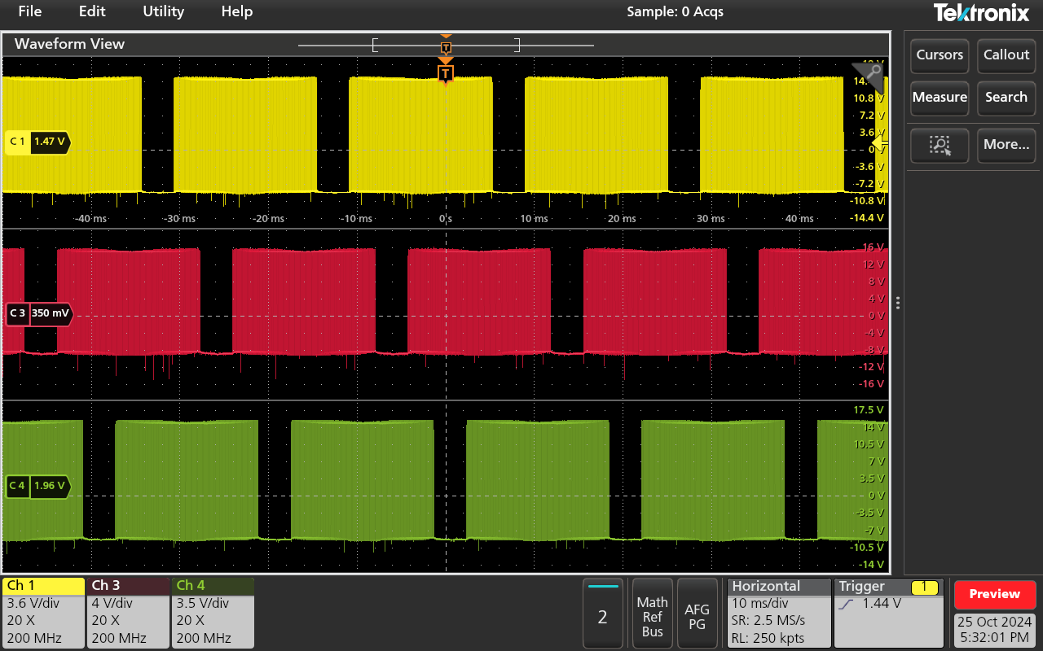
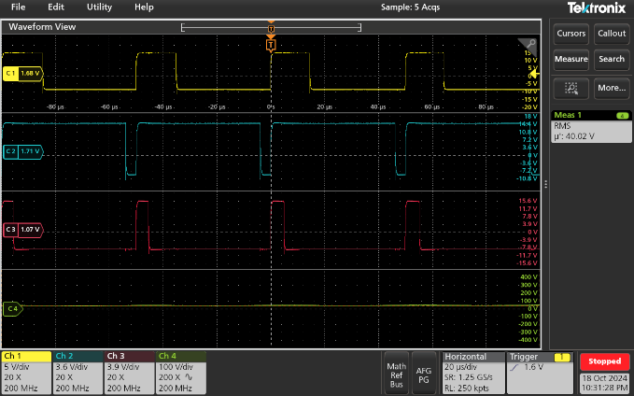
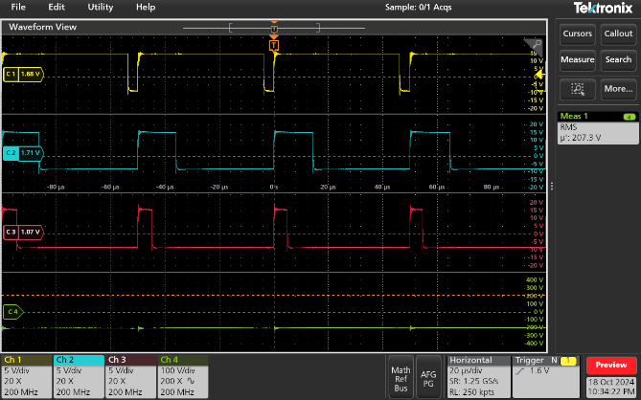
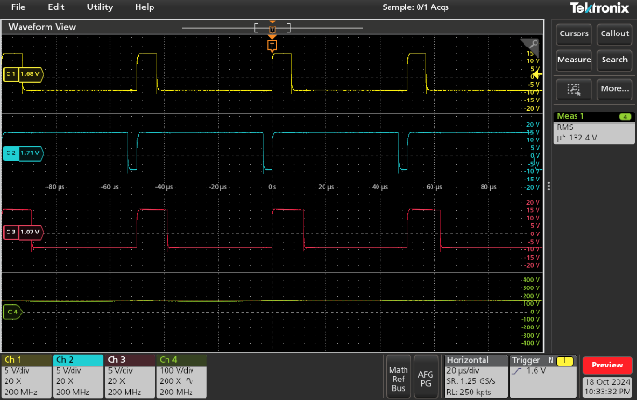
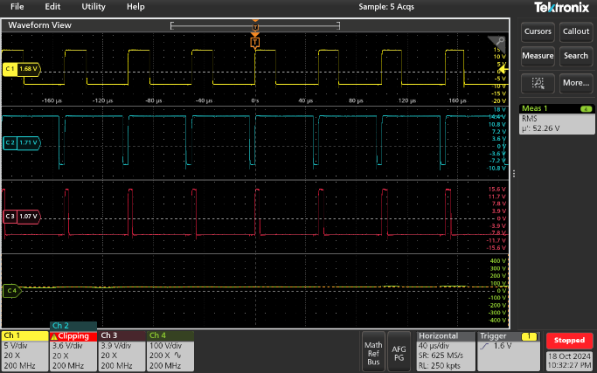
Results
SPWM Pulses
SPWM Pulses
SPWM Pulses at different Voltages

Slide 42
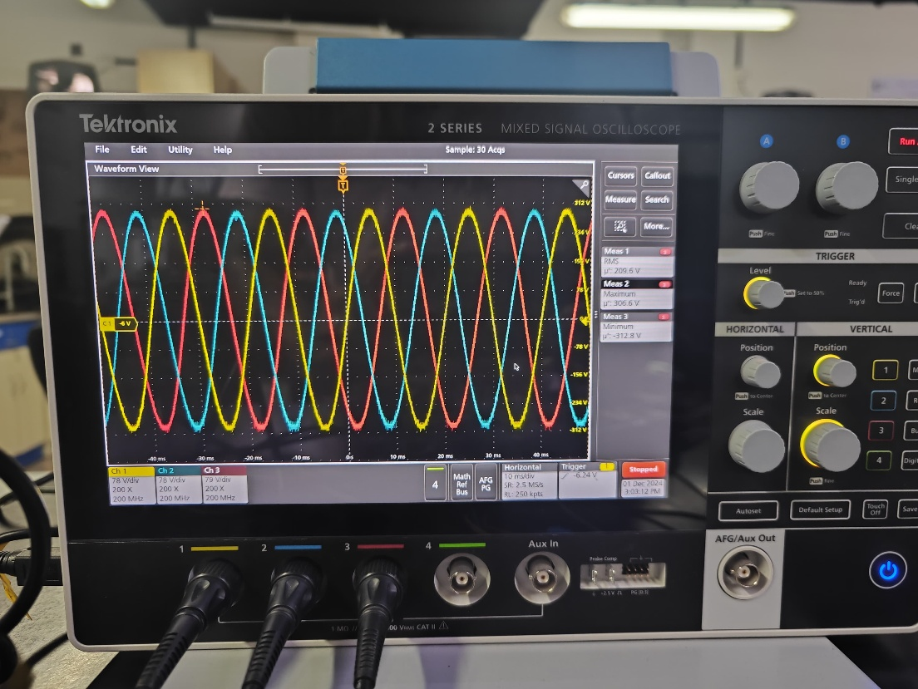
Results
Open Loop Three Phase voltages
Open loop Three phase Voltages

Slide 43
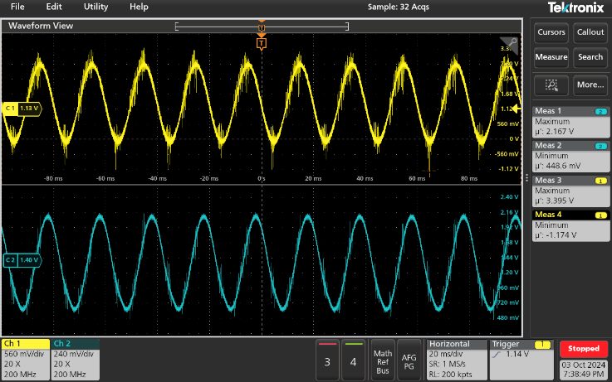


Results
Voltages sensing circuit outputs
Voltage sensing circuit output when connected to Grid
Voltage sensing circuit output when connected to inverter

Slide 44


Results
Current sensing outputs
Current sensing circuit output when connected to Electronic load

Slide 45
Results
Voltage ADC values
Figure: 5.5 (a) ADC Values graph

Slide 46
Results
ABC to DQ
Figure: 5.6 (a) ABC to Alpha Beta
Figure: 5.6(b) Alpha Beta to DQ

Slide 47


Results
Closed Loop Voltages
Closed loop output voltages

Slide 48
Conclusion
The project successfully demonstrated the design, implementation, and testing of a three-phase inverter using an STM32 microcontroller, employing advanced techniques like Sinusoidal Pulse Width Modulation (SPWM) for high-quality sinusoidal output.
Key achievements include the development of a reliable SPWM generation control system, integration of voltage and current sensing circuits for accurate monitoring, and the implementation of closed-loop control to enhance system stability and performance.
A significant contribution of this project was the implementation of the ABC to DQ transformation using power-invariant transformation. This method helped simplify the control of active and reactive power by converting the three-phase system into a two-axis rotating reference frame (dq), aligning the d-axis with the reference vector for more efficient control.
The project addressed several challenges, including waveform distortion, synchronization issues, and noise in the sensing circuits, through iterative improvements in both hardware and software.
Future developments will focus on extending the system to function as a grid-connected inverter, including the implementation of synchronization mechanisms, current control loops, and power factor regulation, ensuring seamless integration with the grid.
The project serves as a solid foundation for future research and development in grid-tied inverter systems, contributing to the advancement of renewable energy technologies and sustainable power solutions.

Slide 49
REFERENCES
Bose, Bimal K., *Modern Power Electronics and AC Dr 2001.
Mohan, Ned, et al., Power Electronics: Converters, Applications, and Design, John Wiley & Sons, 2003.
STMicroelectronics, Digital Power Approach with STM32G4 in 15 kW Bidirectional PFC, ST Application Notes.
Texas Instruments, PWM Generation Techniques for Inverters Using Microcontrollers, TI Application Notes.
Rashid, Muhammad H., Power Electronics Handbook: Devices, Circuits, and Applications, Academic Press, 2010.
Ghosh, Arindam, and Gerard Ledwich, Power Quality Enhancement Using Custom Power Devices, Springer, 2002.
Zubir, M. N., et al., "Voltage Sensing Techniques in Power Inverters," Journal of Power Electronics, 2015.
Venkataraman, Subramanian, et al., "Closed-Loop Control of Three-Phase Inverters," IEEE Transactions on Industrial Electronics, 2020.
Malik, Naveed Anwar, et al., "Phase-Locked Loop Techniques for Inverters," Journal of Electrical Engineering, 2018.
Blaabjerg, Frede, et al., "Future Trends in Power Electronics for Renewable Energy Systems," IEEE Journal of Emerging and Selected Topics in Power Electronics, 2017.

